Slide 1


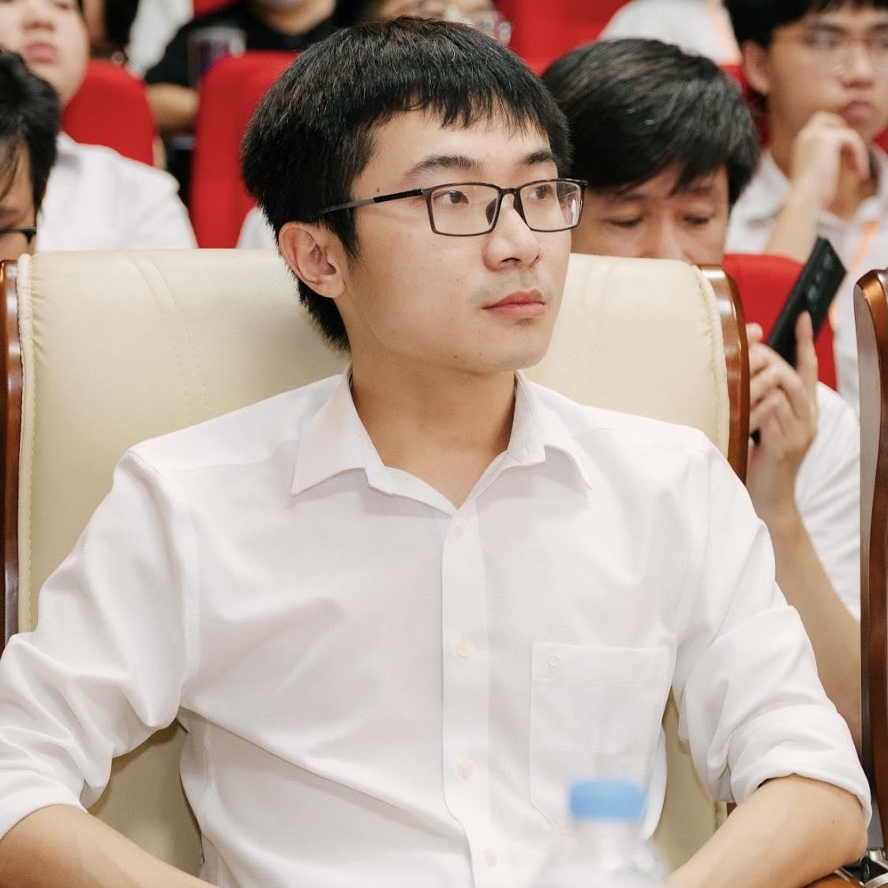
fullstackdatascience.com
Lesson 12 - Python
and Environment Setup
Python
Created by Huydata
DA K6
Lesson 3
huynt@fullstackdatascience.com
1

Slide 2

Learn
About
01/
Python
02/
Environment Setup
fullstackdatascience.com
2

Slide 3
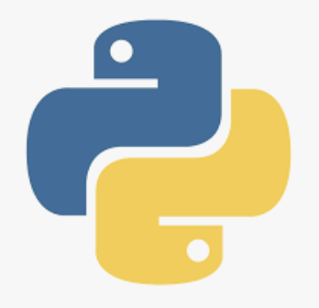
Python
Late 1980s:
Guido van Rossum, a Dutch programmer, started working on a new scripting language at the Centrum Wiskunde & Informatica (CWI) in the Netherlands. He wanted to create a language that was easy to read and write.
3

Slide 4
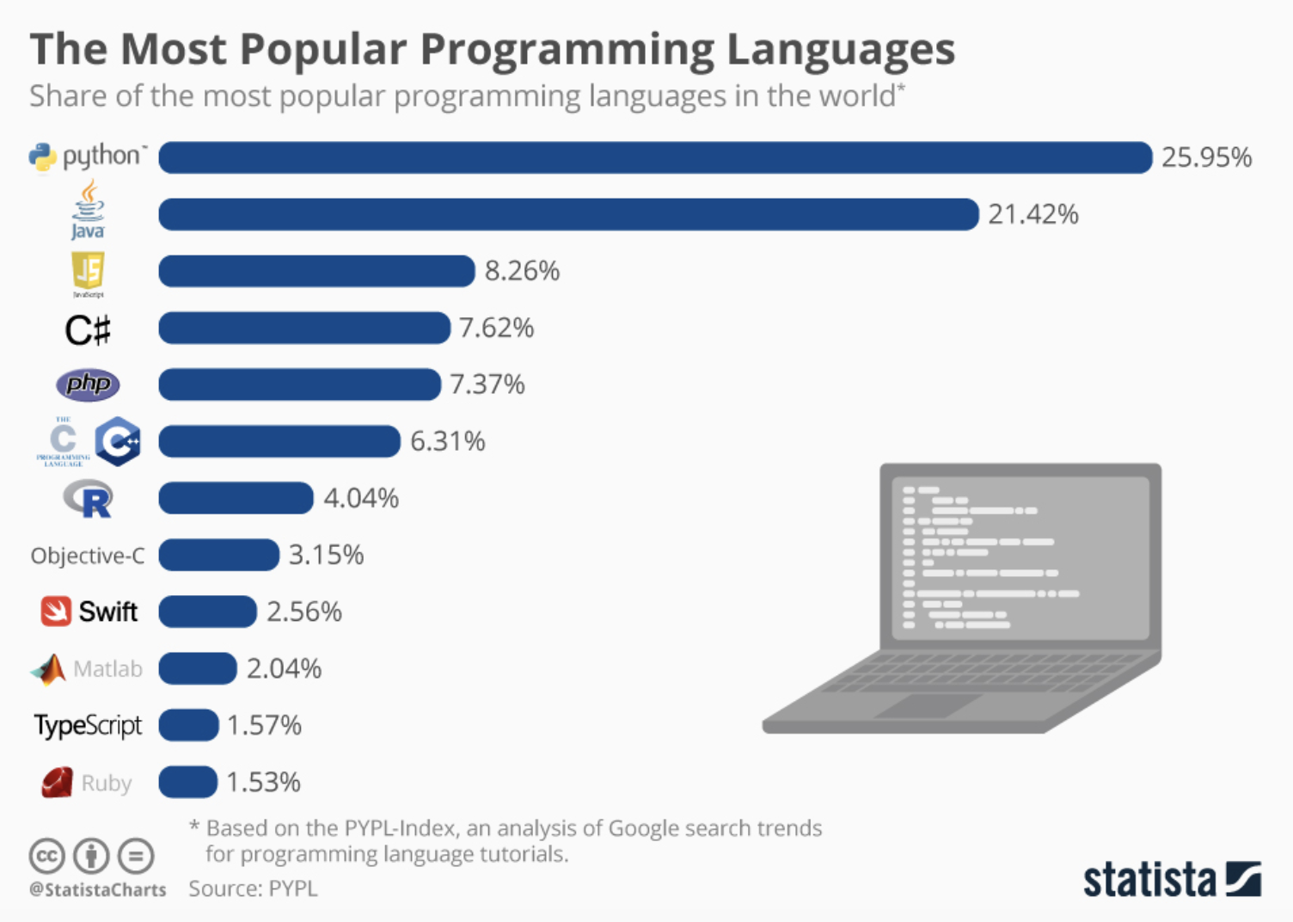
Programming Languages
5

Slide 5
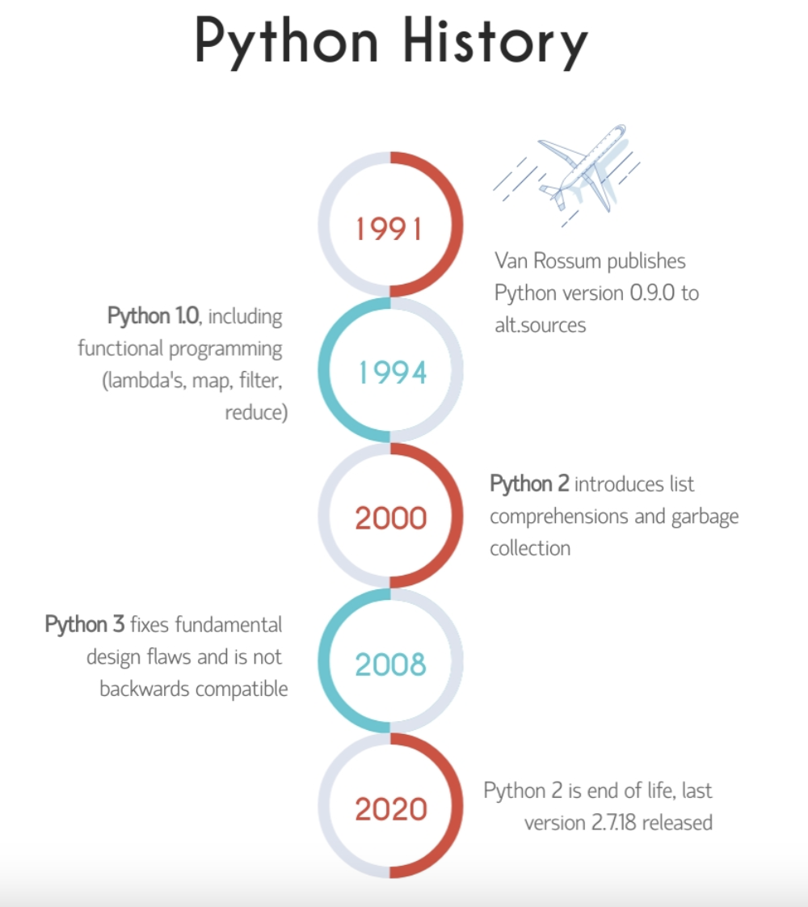
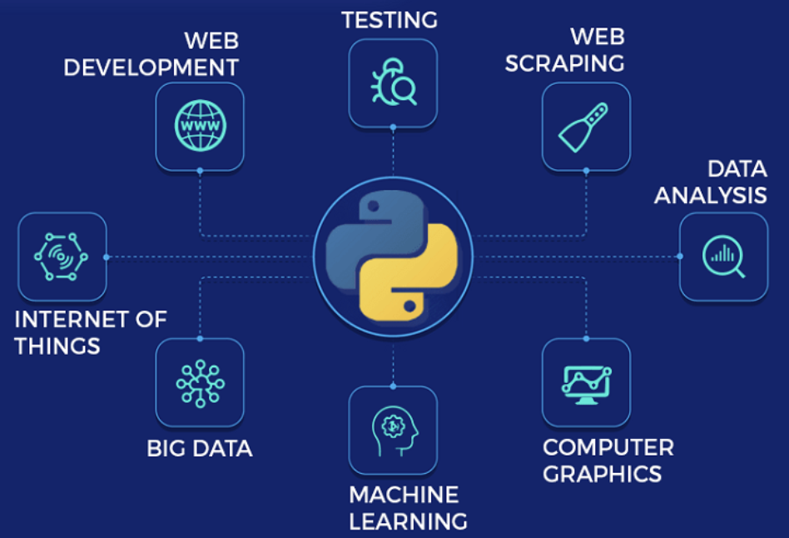
Python - History and Application
5

Slide 6
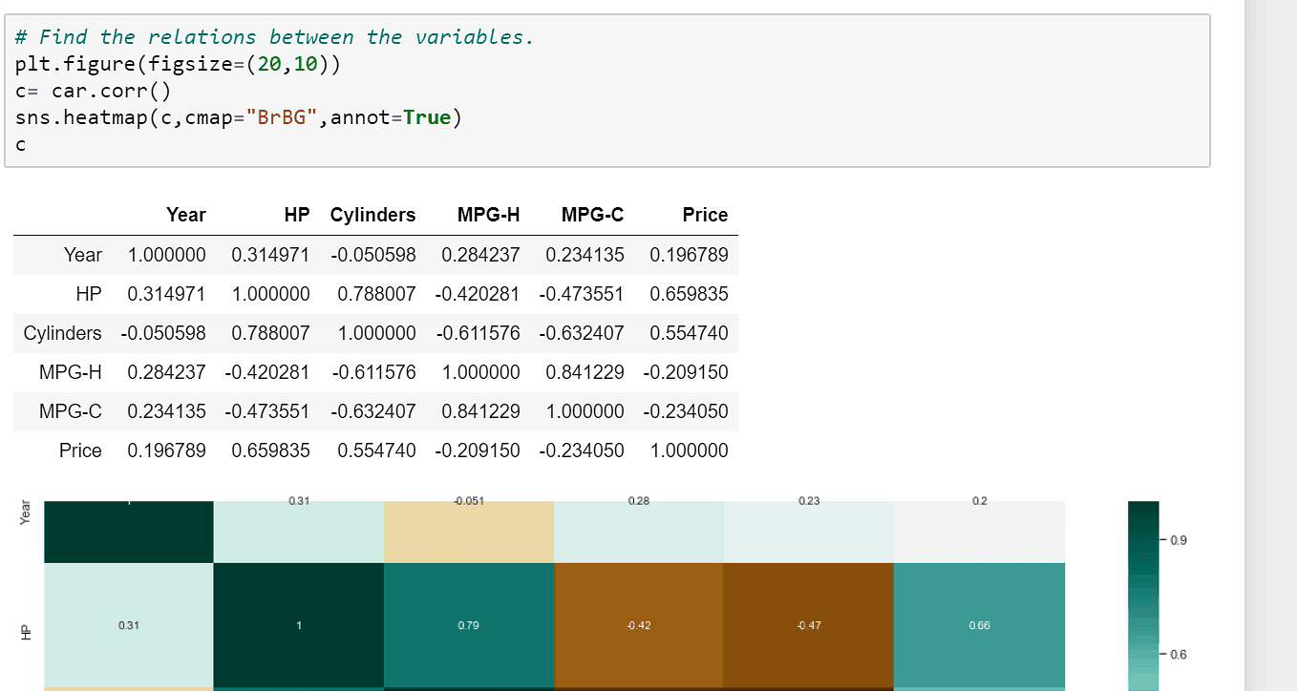
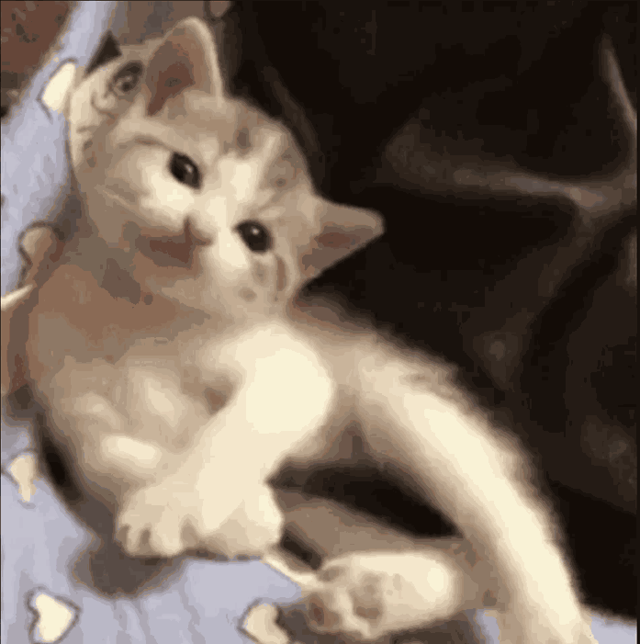
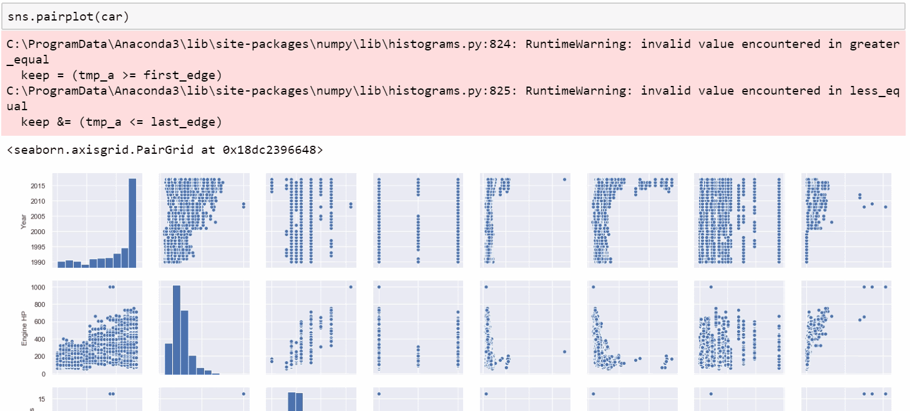
Python demo
Data Analysis
App Gif demo
5

Slide 7
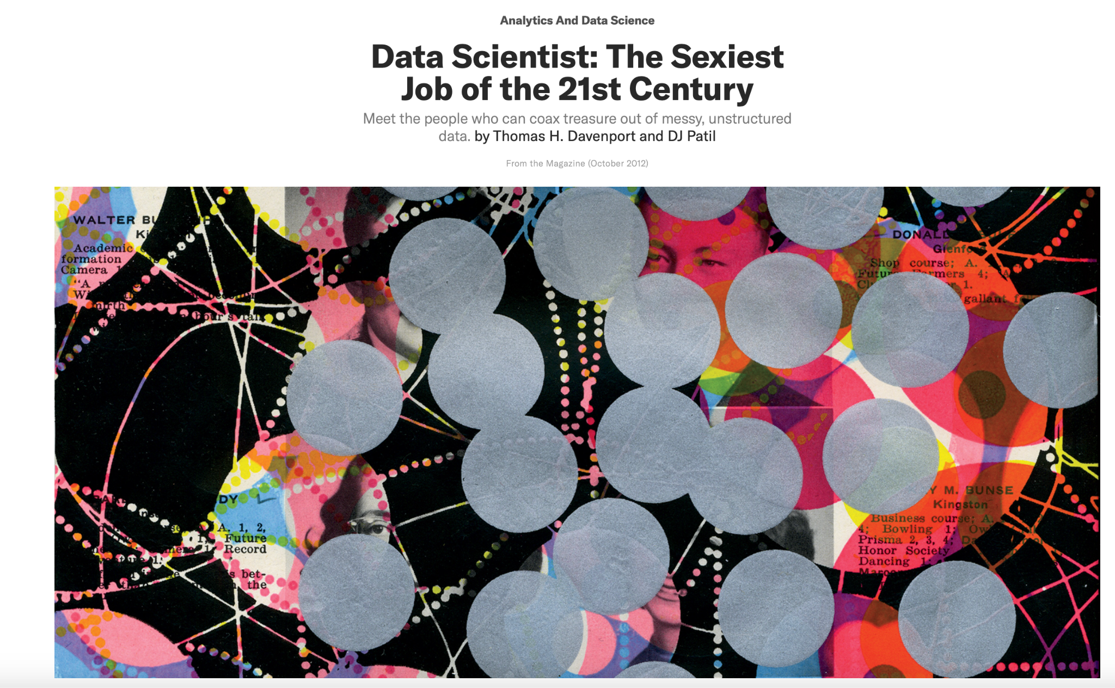
https://hbr.org/2012/10/data-scientist-the-sexiest-job-of-the-21st-century
5

Slide 8

Environment
Setup
3

Slide 9
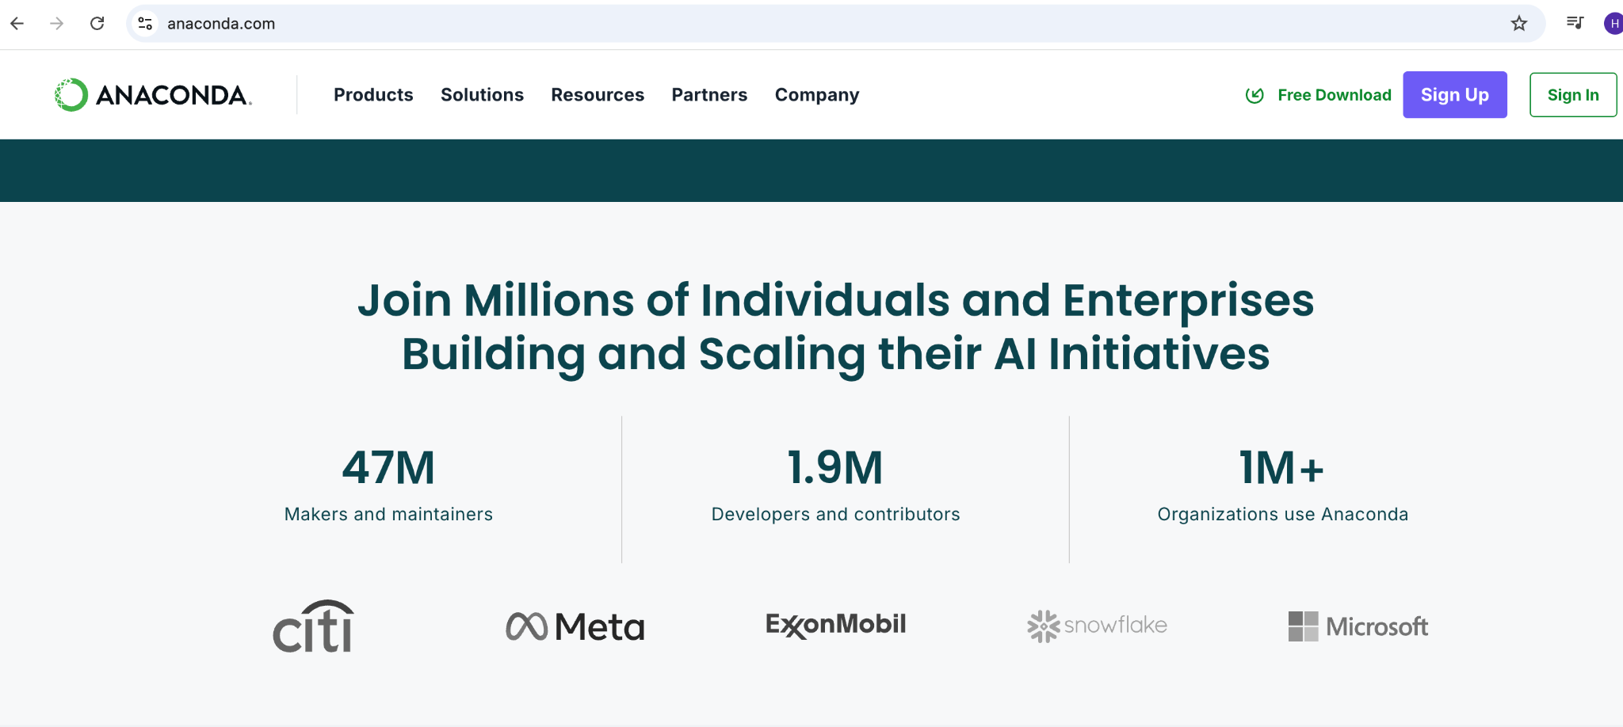
Environment
anacoda.com
5

Slide 10
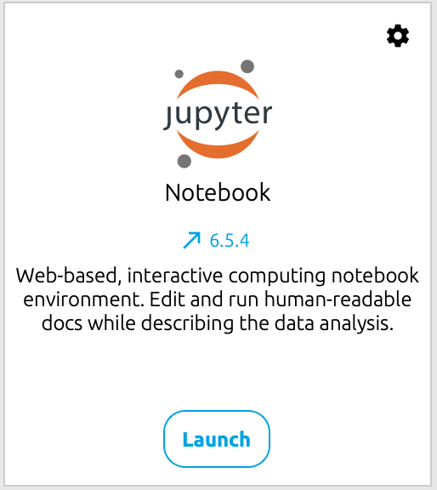
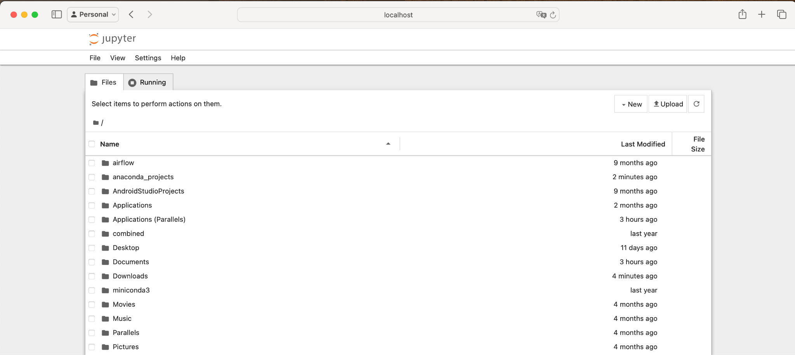
Jupyter Notebook
5

Slide 11

fullstackdatascience.com
References
https://www.python.org/
11

Slide 12





Thank you
096 574 90 25
CREATED BY
Nguyen Tien Huy
info@robusto.ai
fullstackdatascience
huynt@fullstackdatascience.com
Data Manager
https://fullstackdatascience.com/
Hanoi, Vietnam

